Slide 1
Requirement Definition Document & Use Case Analysis
Team Alexandria

Slide 2
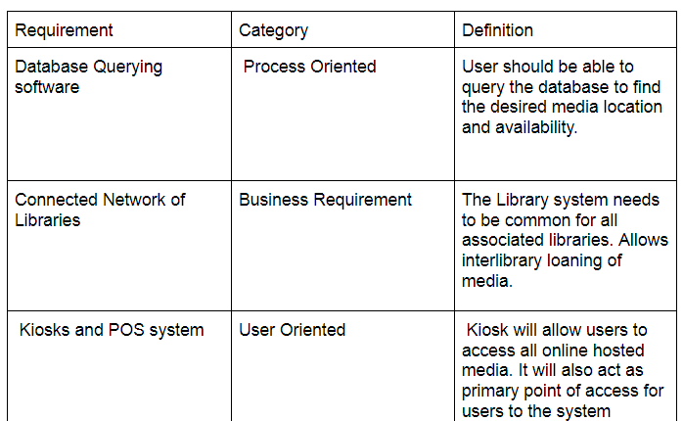
Requirements Definitions

Slide 3
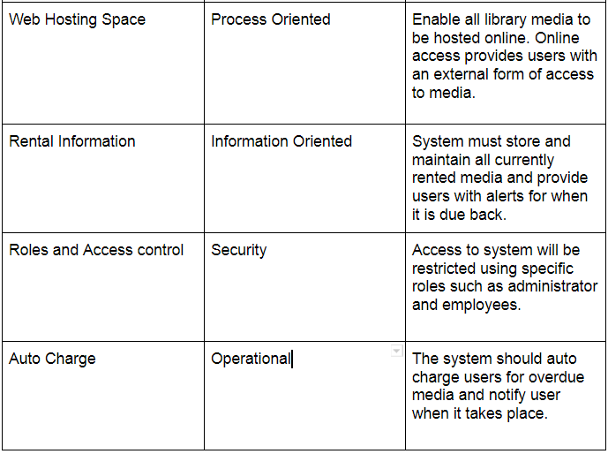
Requirements Definitions (cont)

Slide 4
Interview Format
Name of interviewer, name and position of interviewee, date/time of interview
Questions for Product Owner/Employee:
Who will the users be for this system?
How will you use this system?
What is the most important feature the system needs to perform?
Are there any specific needs to this feature?
What inputs and results will need to be displayed? And to who?
Who will be the primary users of this system?
Where will the users physically use the system?
When will we be ready to start?
How scalable would you like this system to be?
What is the goal of establishing this system?

Slide 5
Observations of Current System
Current system in use is a simple and traditional filing system, hand logging the rentals and data into a card file, inventory is also done by hand, needs several employees to handle everything and transactions are a simple POS system. The system is very dated and requires majority of operations by manual labor. Employee positions: cashier, inventory, membership logging. There is also no online services, i.e. online rentals, membership renewals, online resource access, online purchasing and interlibrary connectivity.

Slide 6
Questionnaire
Questionnaire:
Need for new library management system? (Yes/No)
Need for new revenue outlets for library? (Yes/No)
Satisfaction level of current system. (1 2 3 4 5)
Satisfaction with revenue of library. (1 2 3 4 5)
Enthusiasm for new system. (1 2 3 4 5)

Slide 7
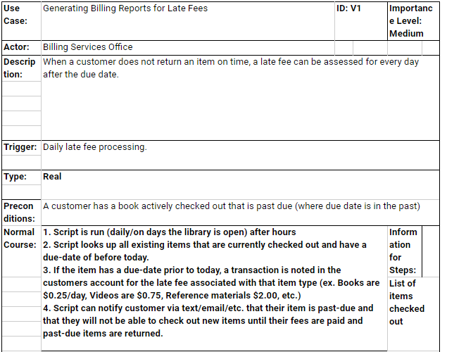
Use Case 1

Slide 8
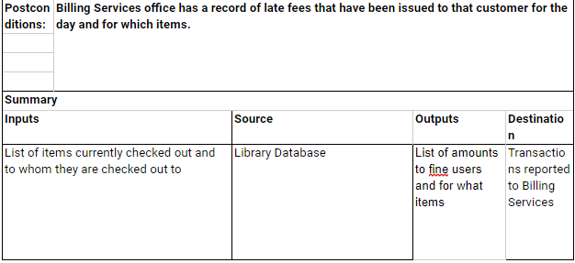
Use Case 1 ( cont)

Slide 9
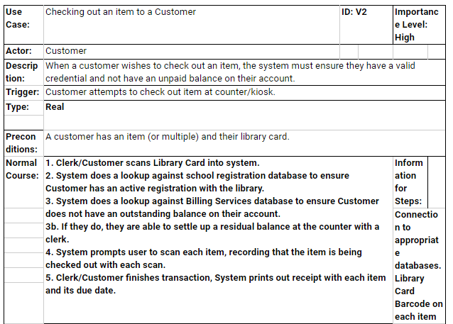
Use Case 2

Slide 10
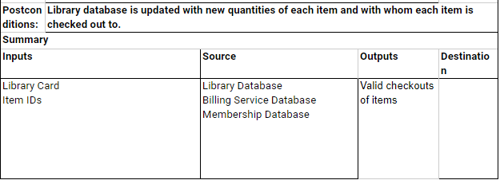
Use Case 2 ( cont)

Slide 11
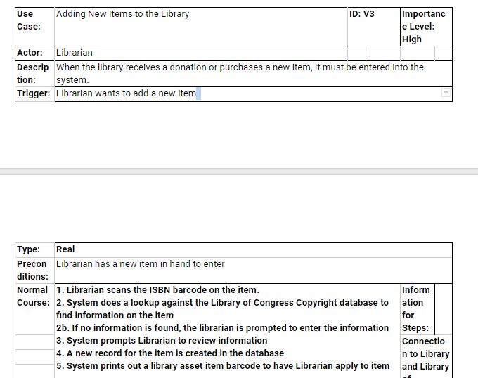
Use Case 3

Slide 12
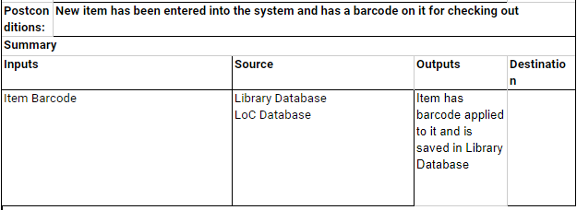
Use Case 3 (cont)

Slide 13
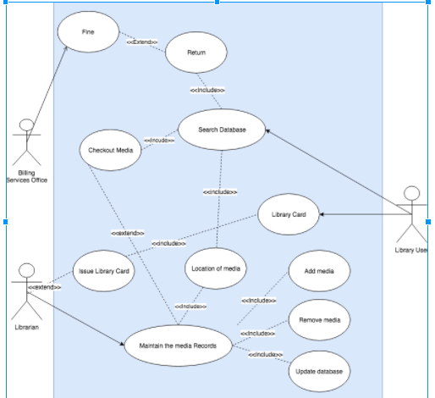
Use Case Diagram

